Slide 1
Essay Grading System
Creating a LSTM model
to grade essays with FLASK Integration

Slide 2
TEAM MEMBERS
Ashutosh Pandey
Jithaamithran S
Pavan Kumar A
Tanisha Mandal

Slide 3
Essays are widely used to assess the capabilities of a candidate for a job or an educational institution. Writing an essay given a prompt requires comprehension of a given prompt, followed by an analysis or argumentation of viewpoints expressed in the prompt, depending on the needs of the testing authority. They give a deep insight into the reasoning abilities and thought processes of the author, and hence are an integral part of standardized tests like the SAT, TOEFL and GMAT.
With essays comes the need for personnel qualified enough to carry out the process of grading the essays appropriately and ranking them on the basis of various testing criteria. Our project aims to automate this process of grading the essays with the aid of Deep learning, in particular, using Long Short Term Memory networks which is a special kind of RNNs.
Automated Essay Scoring(AES) allows the instructor to assign scores easily to the participants with a pre-trained deep learning model. This model is trained in such a way that the scores assigned are in agreement with previous scoring patterns of the instructor. So this needs the dataset which contains the information of scores given by the instructor previously. AES uses Natural Language processing, a branch of artificial intelligence enabling the trained model to understand and interpret human language, to assess essays written in human language.
Introduction

Slide 4
Given the growing number of candidates applying for standardized tests every year, finding a proportionate number of personnel to grade the essay component of these tests is an arduous task. These personnel must be skilled and capable of analysing essays, scoring them according to the requirements of the institution and be able to discern between the good and the excellent.
In addition to this, there are a lot of time constraints in grading multiple essays. This can prove to be cumbersome for a limited number of human essay graders. Having to grade several essays within a deadline can compromise on the quality of grading done. Thus, there is a clear need to automate this process so that the institution carrying out the grading can focus on evaluating other aspects of the candidate's profile.
The challenge was to create a web application to take in the essay and predict a score. We need to train a neural network model to predict the score of the essay in accordance to the rater. The model is to be made using LSTM.
Problem Statement

Slide 5
In order to meet the need for automation of essay grading, we propose an application that provides an interface for users to choose an essay prompt of their choice and provide a response for the same. The user’s response is graded by the application within seconds and a score is displayed.
This application makes use of the technologies of Natural Language Processing that performs operations on textual input, and LSTM, which is used to train a model on how to grade essays. The application also uses Word2Vec embedding technique to convert the essay into vector so that the model can be trained.
It addresses the issue of time constraints; automated grading takes place within seconds as compared to physical grading which requires minutes per essay. The net amount of time saved over a period of consistently using the application is vast; costs of maintaining human graders are also saved upon.
The application gives output from the pre-trained LSTM model. The model is trained using a dataset provided by Hewlett Foundation in 2012 for a competition on Kaggle.
Solution

Slide 6
LSTM is a model that can be used for solving Univariate and Multivariate time series forecasting problems. LSTM is used to learn from the series of past observations to predict the next value in the sequence. It has the ability to learn the context required to make predictions, rather than having this context pre-specified and fixed.
With LSTM, the user can select multidimensional functionality for the target variable specifically. The multidimensional functionality allows the user to predict the accuracy or predict the model’s accuracy for multiple dimensions. LSTM is a technique that employs data models and uses statistical tools to predict outcomes. Although LSTM cannot perform future analysis with 100% accuracy, it can predict the possible outcome.
The model score shows the mean of the actual value and the predicted value. The model score should be as small as possible. If the model score is zero, it means it is the best fit model. The best fit model shows there is no difference between the actual value and the predicted value. If the model score is more than zero, you can tweak some parameters to improve the model score.
LSTM

Slide 7
Word2vec is a technique/model to produce word embedding for better word representation. It is a natural language processing method that captures a large number of precise syntactic and semantic word relationships. It is a shallow two-layered neural network that can detect synonymous words and suggest additional words for partial sentences once it is trained.
Word2vec is a two-layer network where there is input one hidden layer and output.
Word2vec represents words in vector space representation. Words are represented in the form of vectors and placement is done in such a way that similar meaning words appear together and dissimilar words are located far away. This is also termed as a semantic relationship. Neural networks do not understand text instead they understand only numbers. Word Embedding provides a way to convert text to a numeric vector.
Word2vec reconstructs the linguistic context of words. Before going further let us understand, what is linguistic context? In general life scenario when we speak or write to communicate, other people try to figure out what is objective of the sentence. For example, "What is the temperature of India", here the context is the user wants to know "temperature of India" which is context. In short, the main objective of a sentence is context. Word or sentence surrounding spoken or written language (disclosure) helps in determining the meaning of context. Word2vec learns vector representation of words through the contexts.
Word2Vec

Slide 8
The kappa score takes into consideration that some correct predictions were made by 'accident':
K=p0-pe/1-pe
with p0 being the accuracy and pe the proportion of 'accidentally' correct classified examples.
For the binary classification task, pe is calculated with:
pe=(TP+FN)⋅(TP+FP)/b^2+(FN+TN)⋅(FP+TN)/b^2
with b the total number of examples.
And in general for (n) different classes:
pe=(1/b^2)⋅∑(i=1,n)hi+⋅h+i
with the sum of row i :hi+ and the sum of column i:h+i
Kappa Score

Slide 9
Flask
Our application makes use of Flask to integrate all the components and make them work in unison.
Flask is a micro web framework written in Python. It is classified as a microframework because it does not require particular tools or libraries. It has no database abstraction layer, form validation, or any other components where pre-existing third-party libraries provide common functions. However, Flask supports extensions that can add application features as if they were implemented in Flask itself. Extensions exist for object-relational mappers, form validation, upload handling, various open authentication technologies and several common framework related tools.

Slide 10

Home Page
Output Screenshots

Slide 11
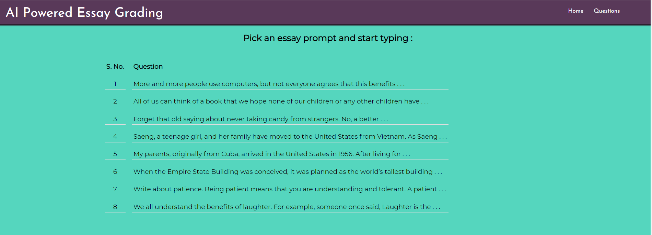
Choose a Prompt Page

Slide 12
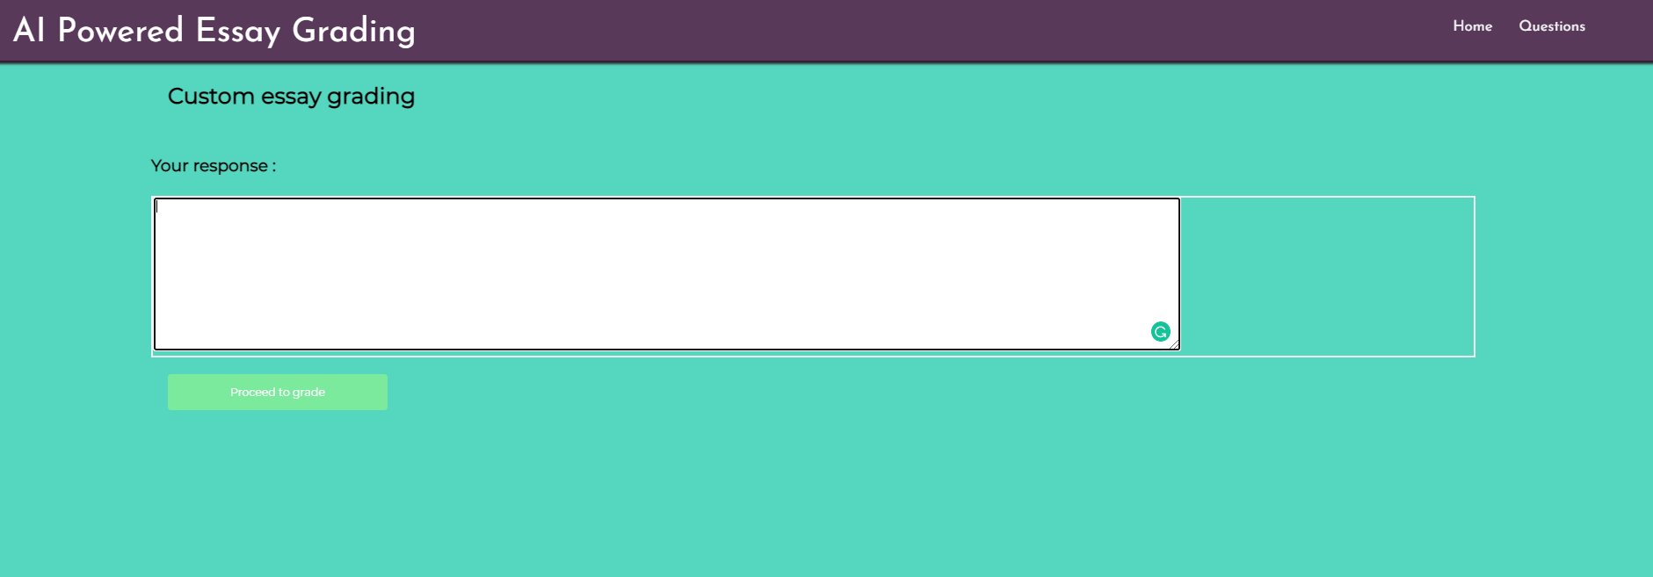
Custom Essay Writing Page

Slide 13
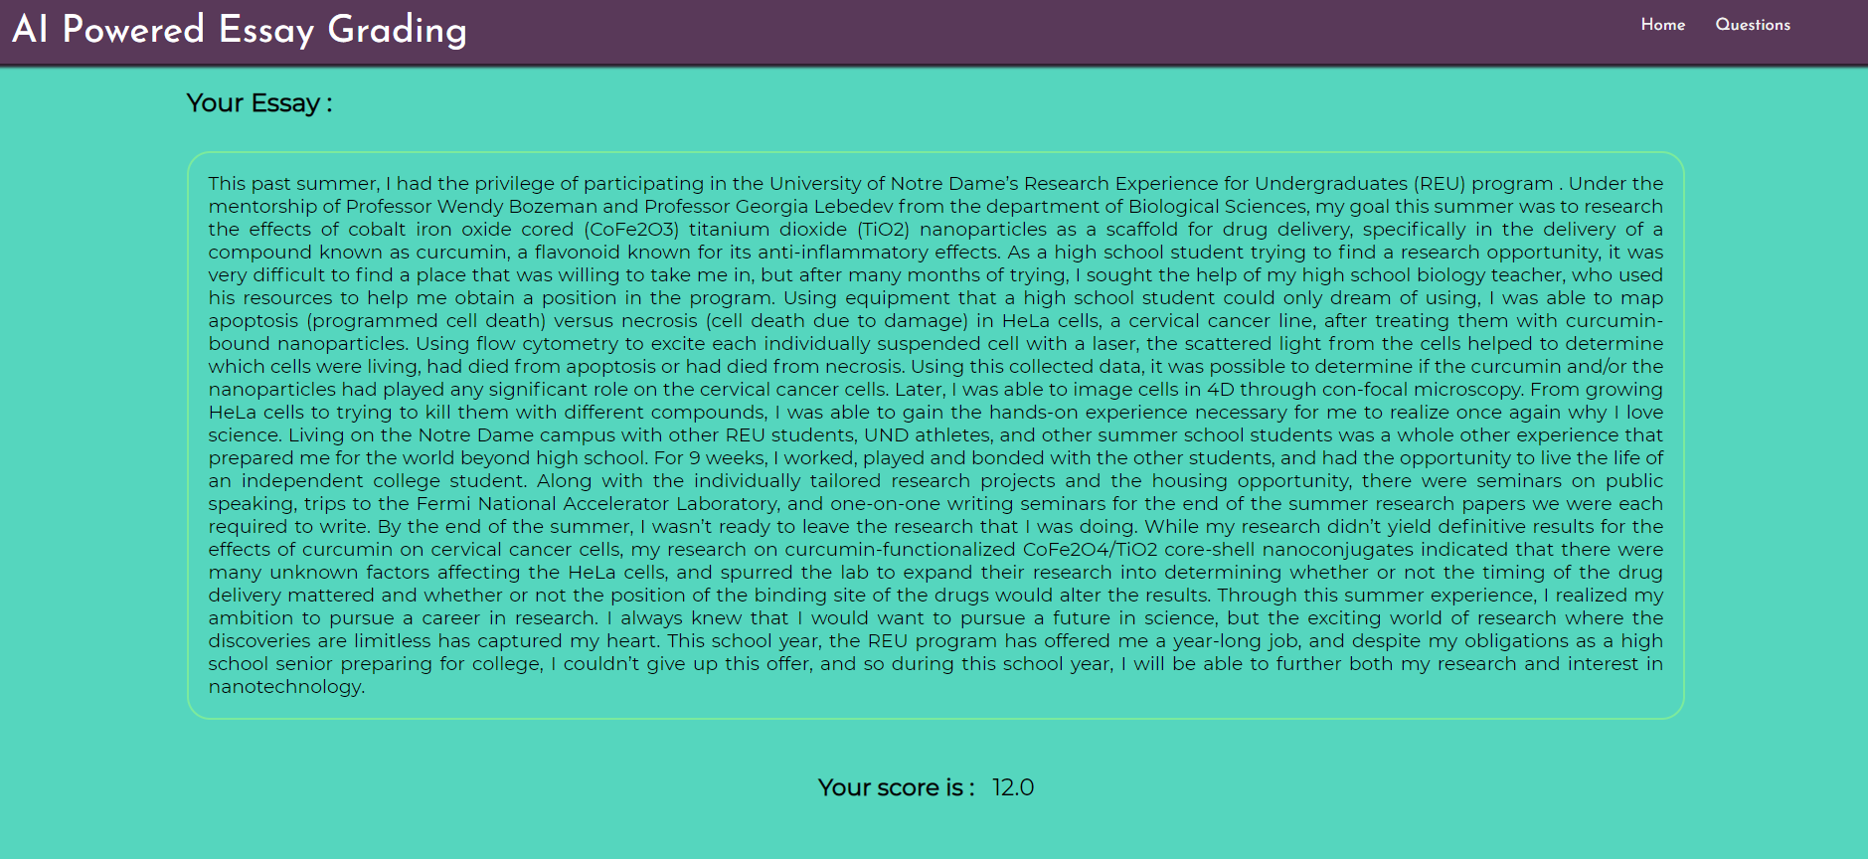
Sample Custom Essay Grading

Slide 14
Links

Slide 15
THANK YOU

